Slide 1
Project 1
Mitron Bank Analysis
Project
PORTFOLIO
Project 2
AtliQ Grand Hospitality analysis
Project 3
AtliQ Superstore Analysis
CONTENTS
Project 4
Superstores Dashboard

Slide 2
Project 5
Voyage City Transit Analysis
Project 8
RM Hospital Analysis
Project 6
Hospital Analysis
Project 9
Sales And Transaction analysis of AtliQ Hardware
Project 10
AtliQ hardware SQL challenge
Project 7
Madhave store Analysis

Slide 3
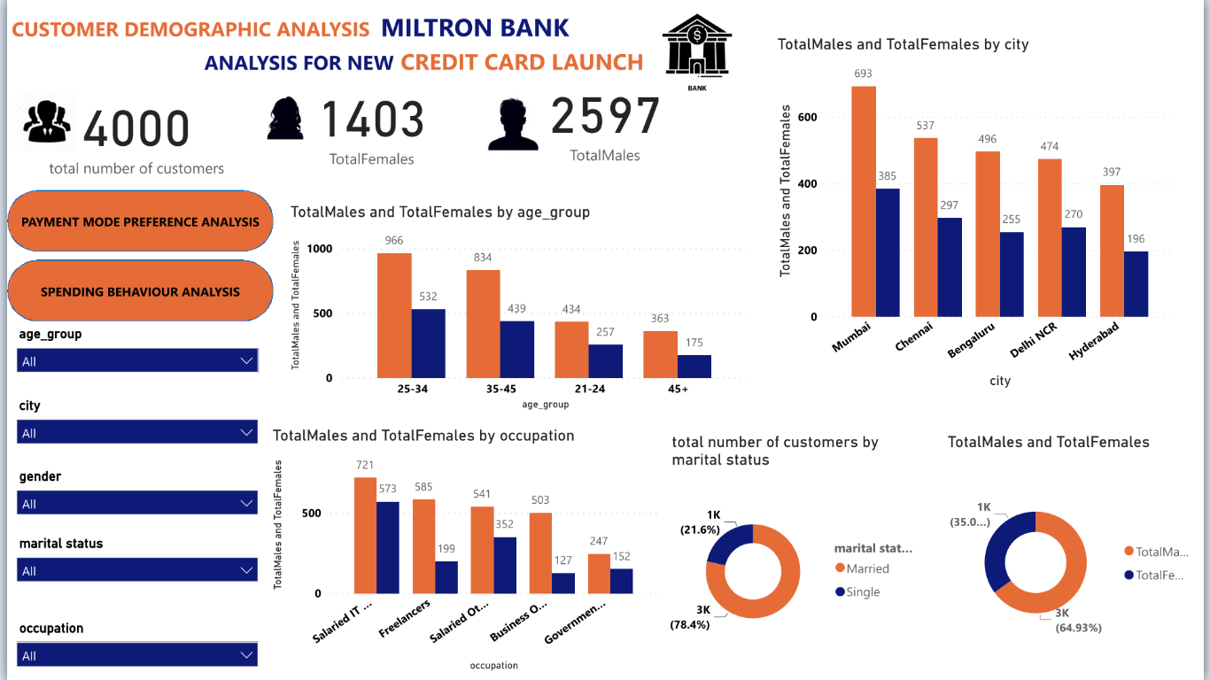
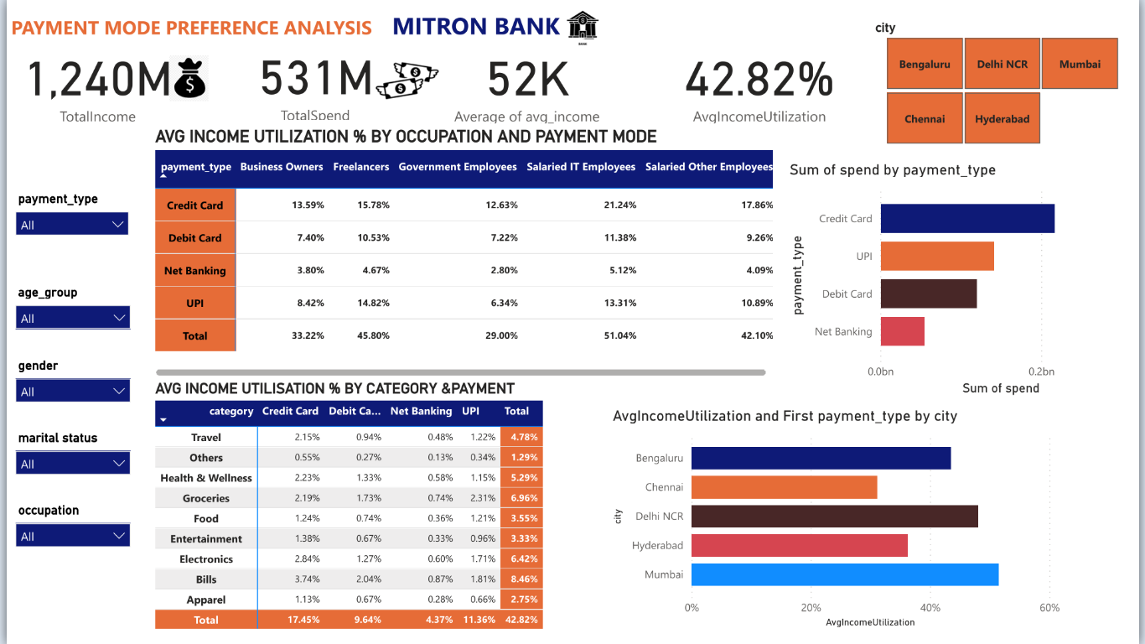
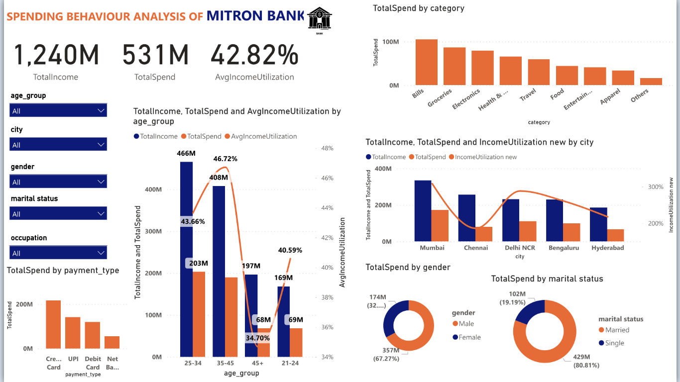
PROJECT
1
PROJECT
1
MITRON BANK ANALYSIS
Mitron Bank is a legacy financial institution headquartered in Hyderabad. They want to introduce a new line of credit cards, aiming to broaden its product offerings and reach in the financial market.
Key objective
1.Analyzed Demographic Classification
2. payment mode preference analysis
3. spending behaviour

Slide 4
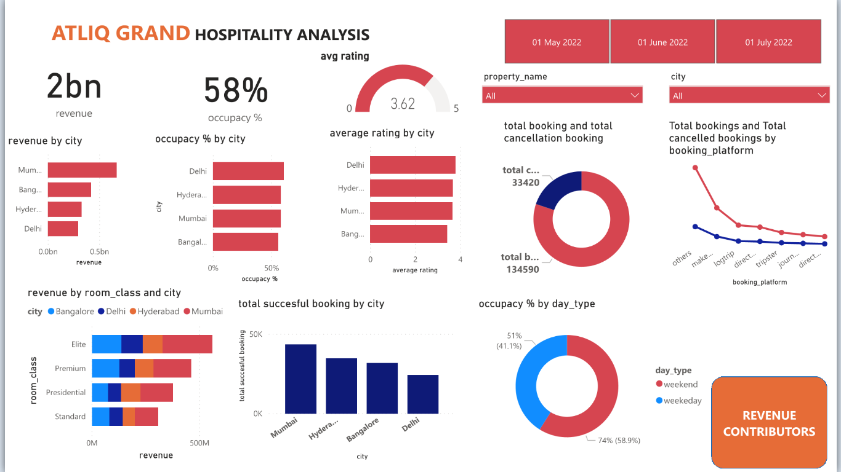
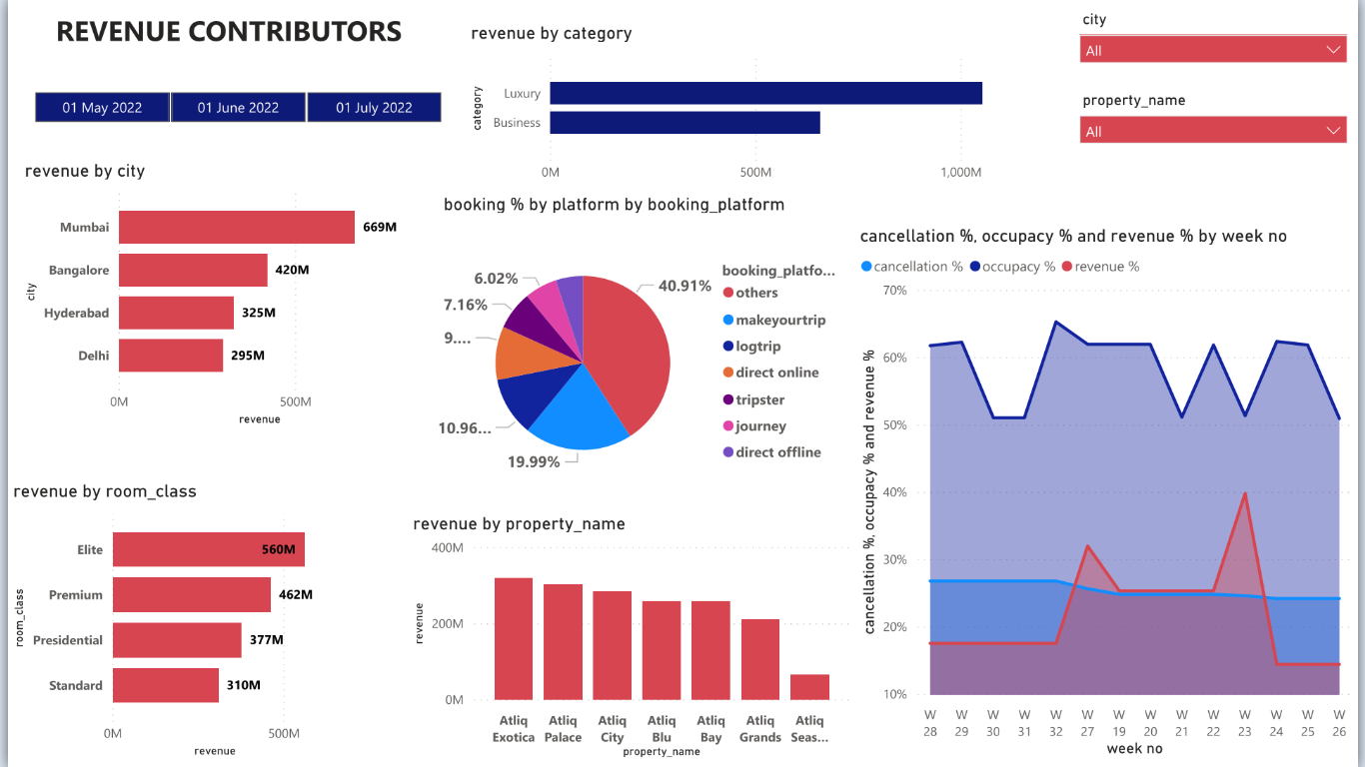
PROJECT
2
ATLIQ GRAND HOSPITALITY ANALYSIS
Atliq Grands owns multiple five-star hotels across India. They have been in the hospitality industry for the past 20 years. Due to strategic moves from other competitors and ineffective decision-making in management, Atliq Grands are losing its market share and revenue in the luxury/business hotels category. As a strategic move, the managing director of Atliq Grands wanted to incorporate “Business and Data Intelligence” to regain their market share and revenue. However, they do not have an in-house data analytics team to provide them with these insights.

Slide 5
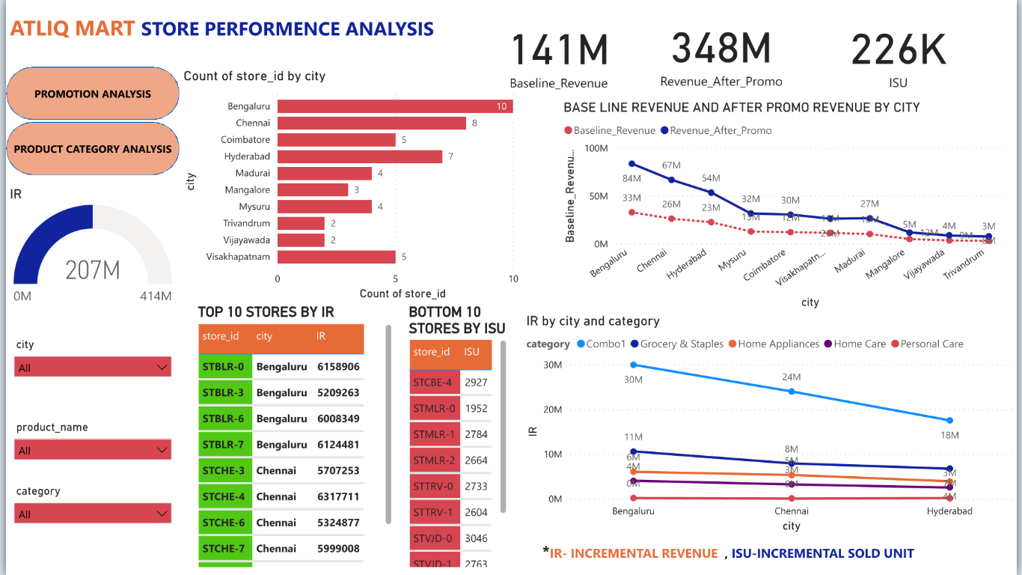
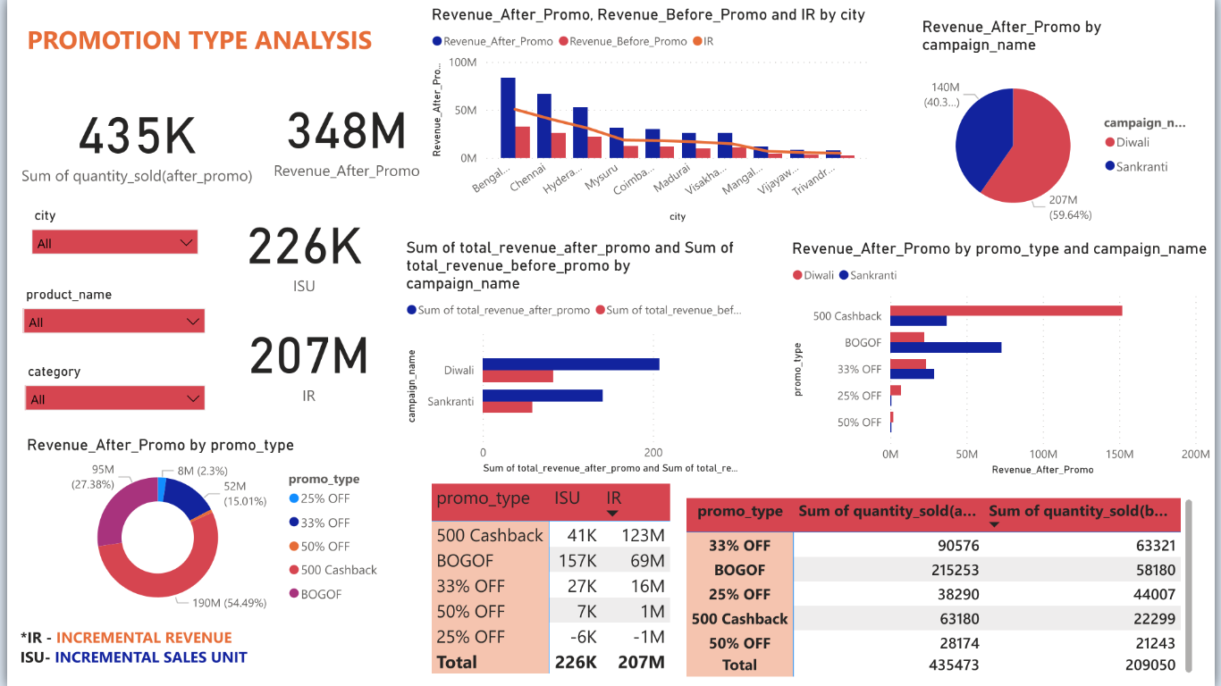
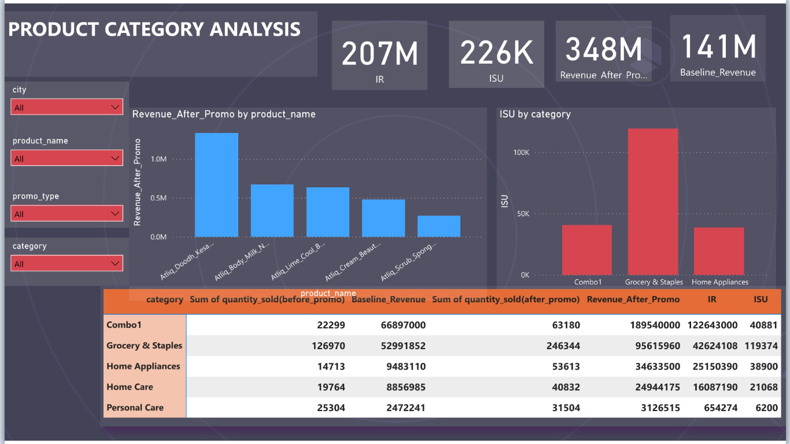
PROJECT
3
ATLIQ SUPERMARKET
ANALYSIS
AtliQ Mart is a retail giant with over 50 supermarkets in the southern region of India. All their 50 stores ran a massive promotion during the Diwali 2023 and Sankranti 2024 (festive time in India) on their AtliQ branded products. Now the sales director wants to understand which promotions did well and which did not so that they can make informed decisions for their next promotional period. Key Objective 1. Store performance analysis 2. Promotion type analysis 3. Product category analysis

Slide 6
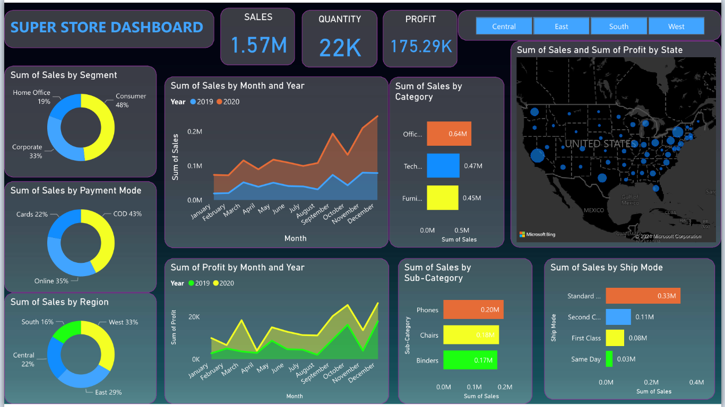
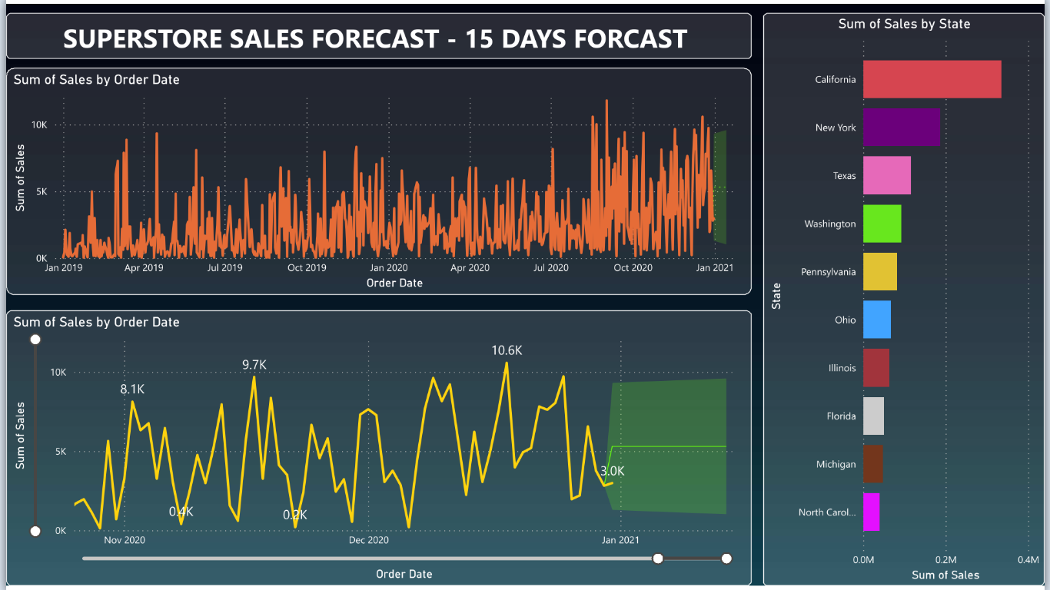
PROJECT
4
SUPERSTORES DASHBOARD
OBJECTIVE To contribute to the success of a business by utilizing data analysis techniques , specifically focusing on time series analysis , to provide valuable insight and accurate sales forecasting . Matrix used 1. Sum 2. Average Learnings Incorporated data analysis techniques , specializing in time series analysis, to deliver valuable insight , accurate sales forecasting and interactive dashboard creation, driving business success

Slide 7
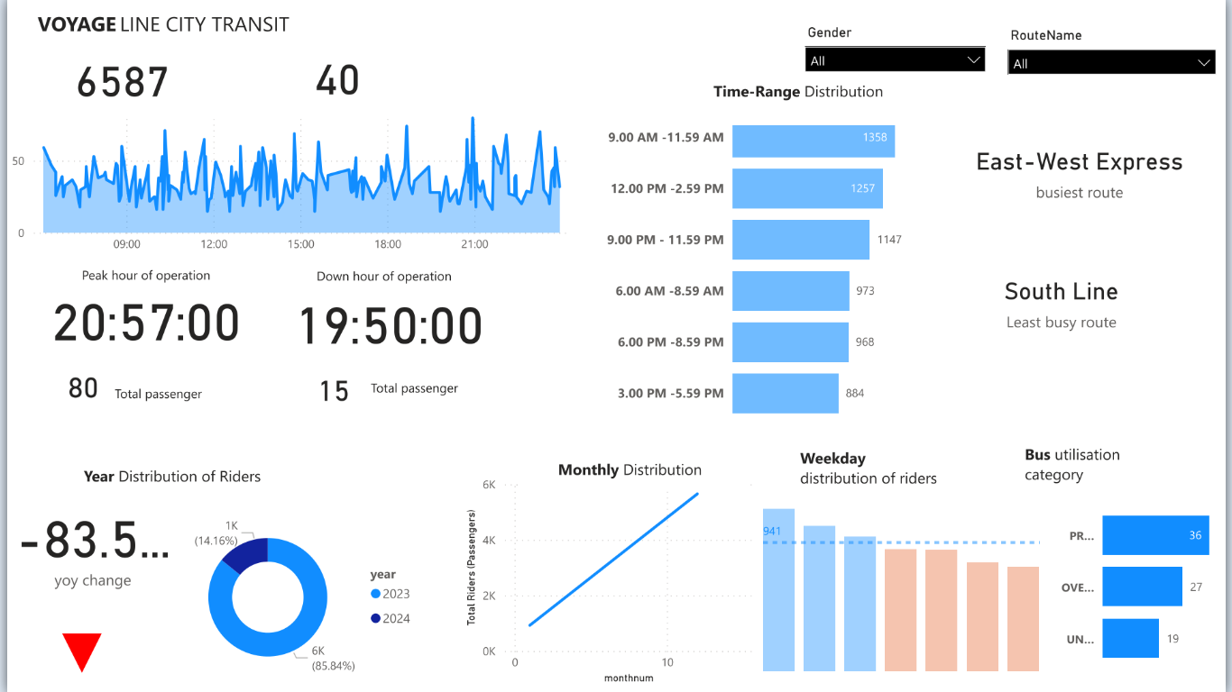
PROJECT
5
5
VOYAGE LINE CITY TRANSIT ANALYSIS
Bus analysis This data shows all the information of voyage city transit , which shows details of buses Object Create visualised dashboard which shows peak hour operation , least hour operation ,busiest route ,year distribution of riders and buses utilisation DAX function used 1. Count 2. Sum 3. Divide

Slide 8
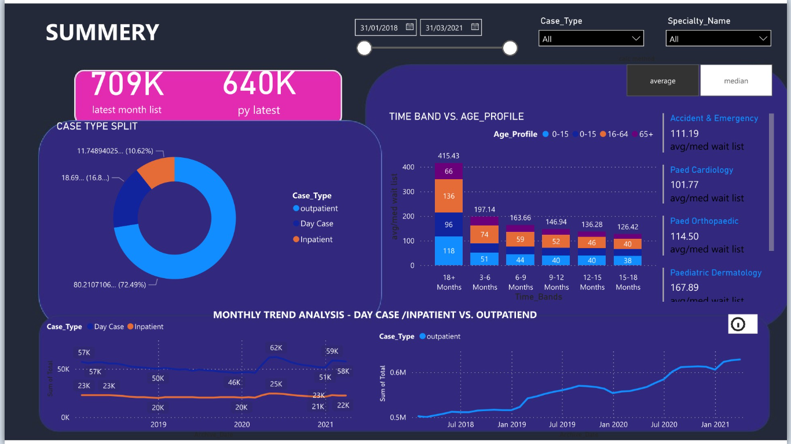
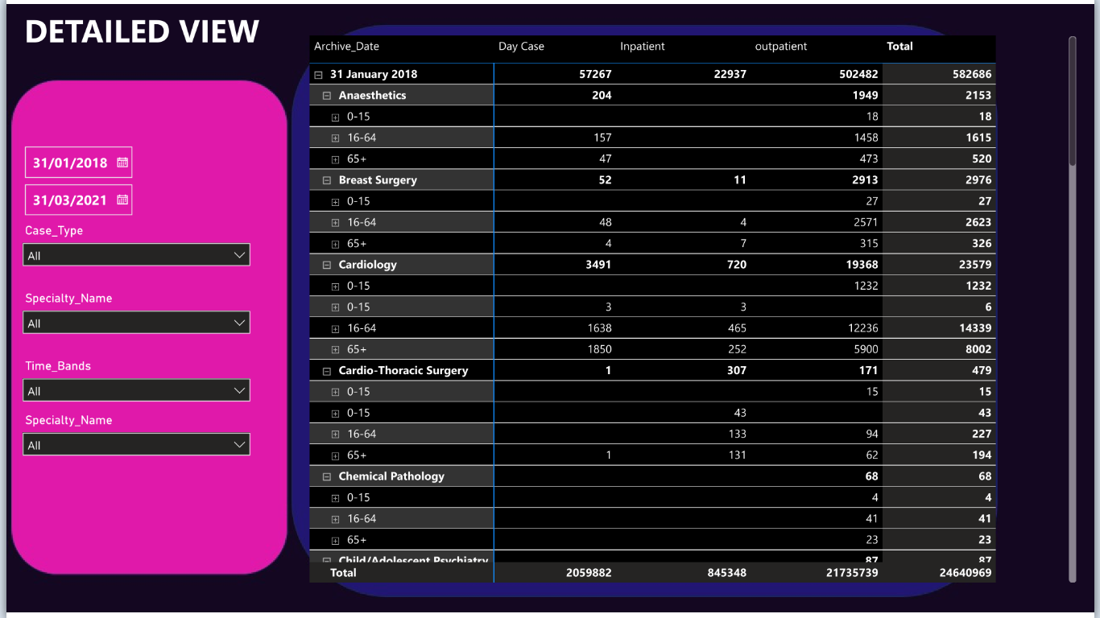
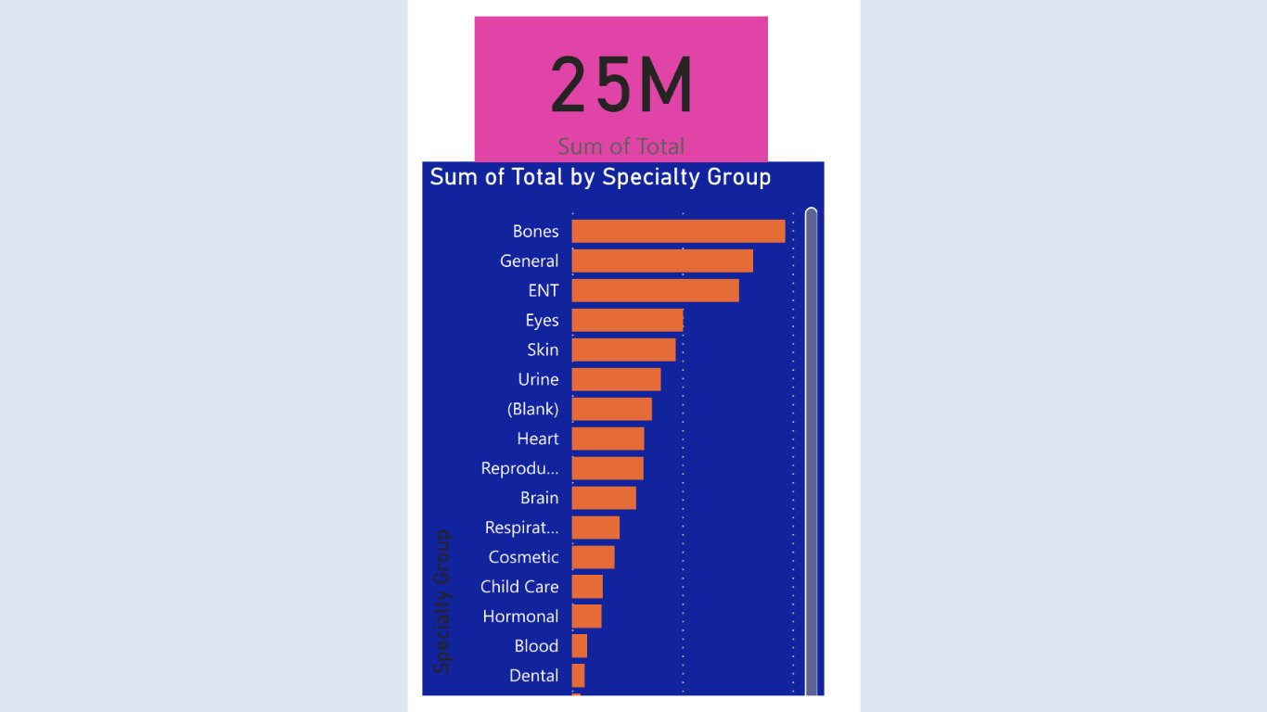
PROJECT
6
HOSPITAL
ANALYSIS
HOPITAL PROJECT This is publicly available health care data ,there are two type of data 1 . Inpatient data 2.Outpatient data Objective To create attractive dashboard that shows both median and average value of patients and To find monthly trend analysis of 2018,2019,2020,2021. And the table that shows detailed view of patients . use drill down to show another page.
Matrix used 1. Median 2. Average

Slide 9
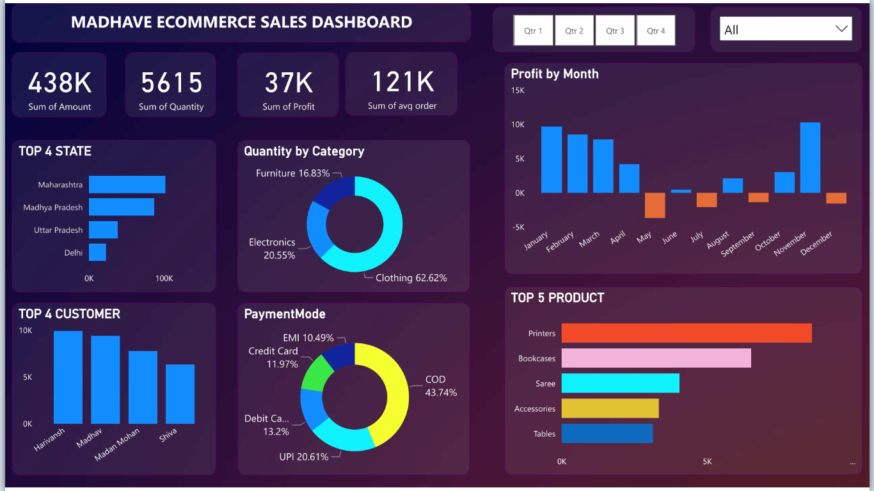
PROJECT
7
MADHAVE STORE ANALYSIS
Madhave store Analysed e-commerce sales data created or interacted using power bi Objective Owner of Madhave stores want to create a dashboard to track their online sales across India.
Learnings Created interactive dashboard to track and analyse online sales data Created connections, join new tables , calculations to manipulate data and enable user driven parameter for visualisations. Used different types of customized visualisation (bar chart, donut chart ,slicers

Slide 10
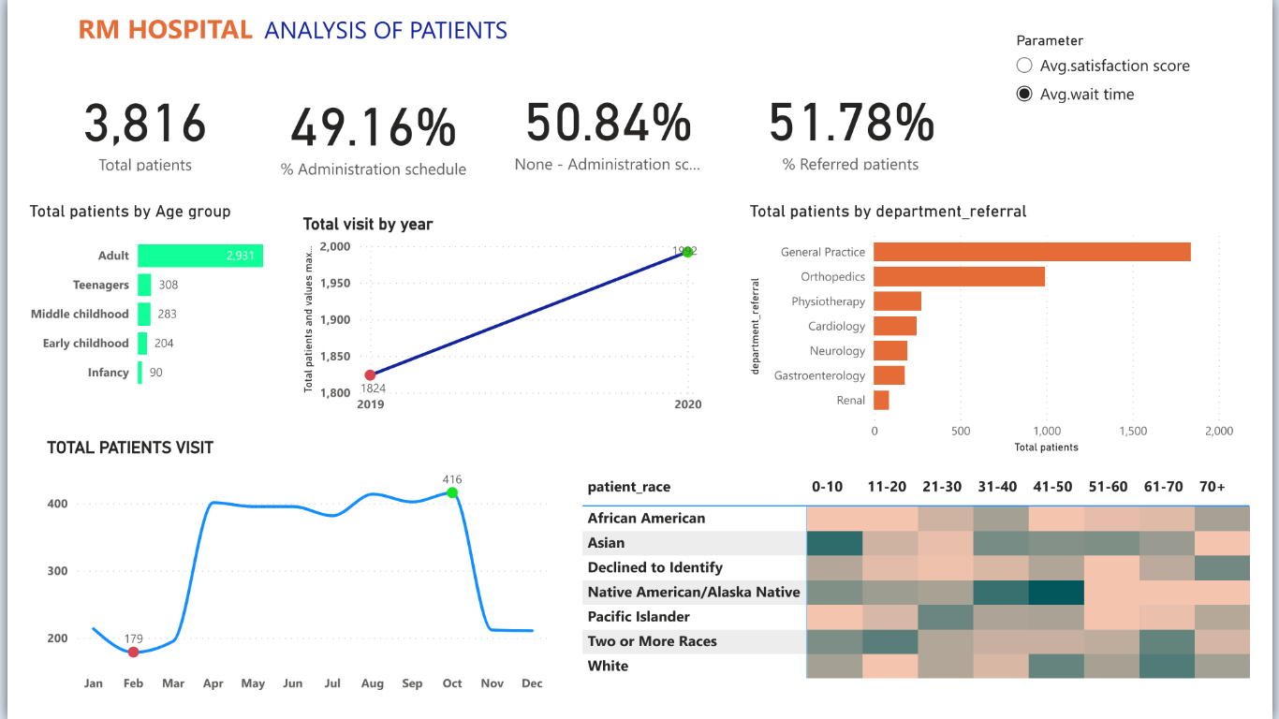
PROJECT
8
RM HOSPITAL ANLYSIS OF PATIENTS
Hospital Project
Provided data shows patients details of RM Hospitals. OBJECTIVE To analyse the details of patients data set to find out total patient visit of 2019-2020 and find the patients referrals.
RESULT · Result shows that general patients are more referred patients . · In 2019 there is 1824 patients only but in 2020 patients are increased to 2000 that is clearly visible . · Highest number of patients visited in October month .

Slide 11
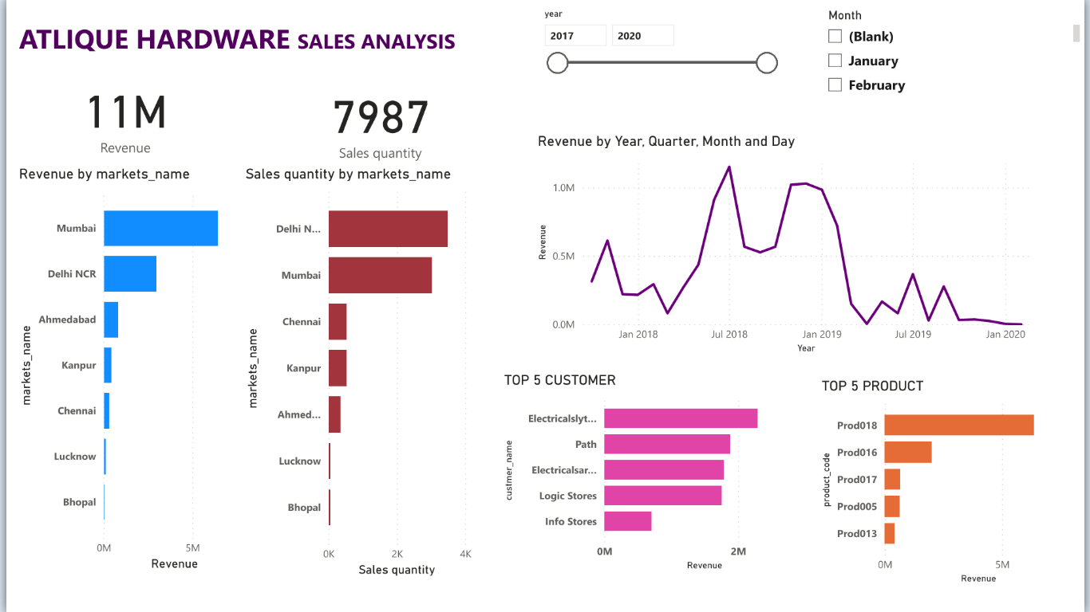
PROJECT
9
SALES AND TRANSACTION ANALYSIS OF ATLIQ HARDWARE
SALES AND TRANSACTION Atliq Hardware is a company which supplies computer hardware and peripherals to many clients . they have reginal office across India. When market growing dynamically they facing problem in tracking sales so they need simple and understanding insight to track sales . PURPOSE To unlock sales insight that are not visible and automate them to reduce manual time spend in data gathering . RESULT An automated dashboard providing quick and latest insight in order to support data driven decision making

Slide 12
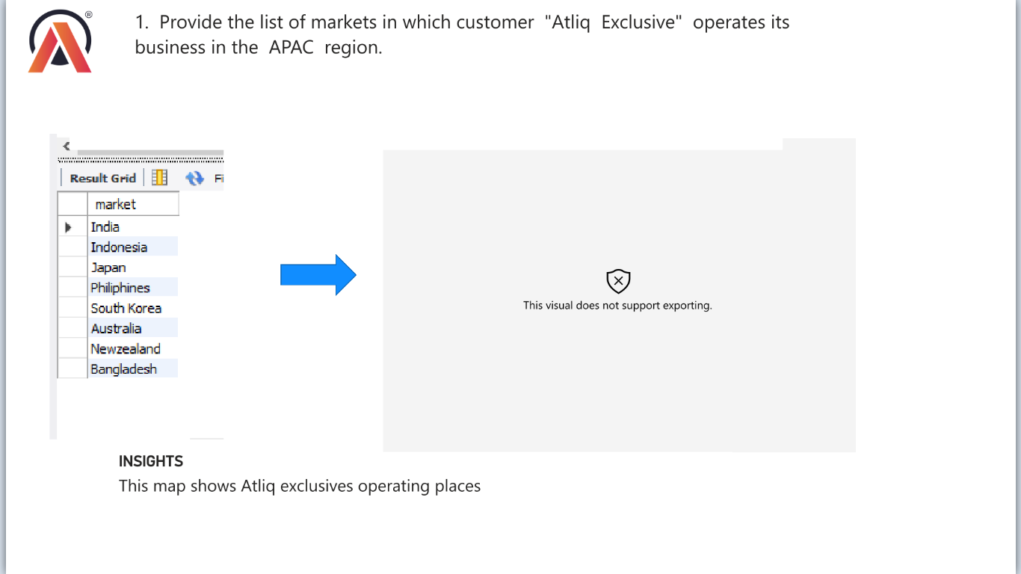
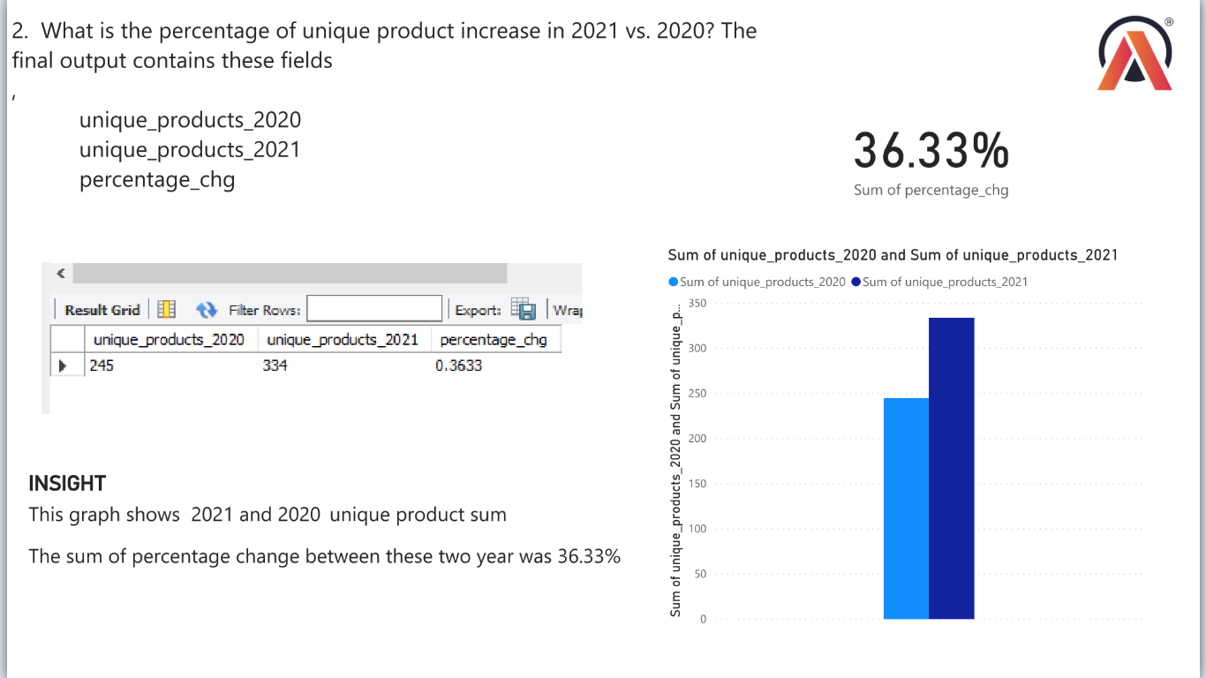
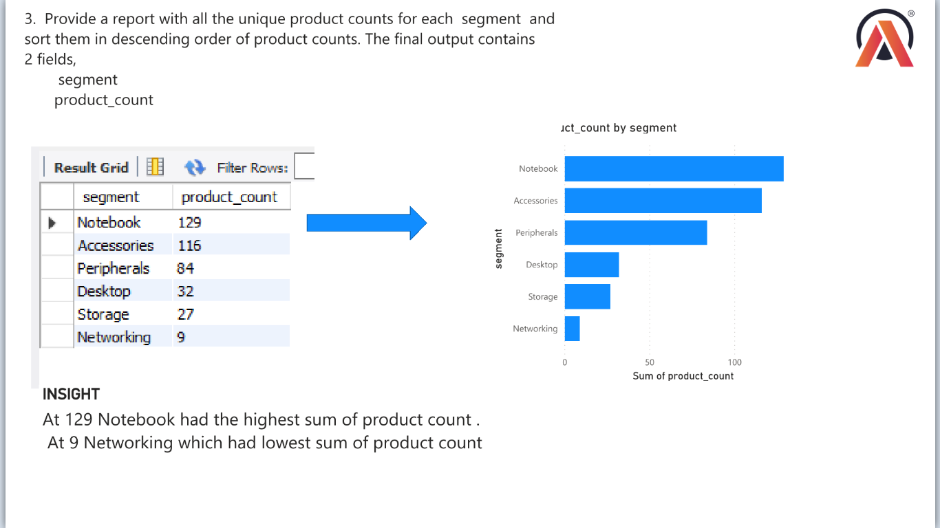
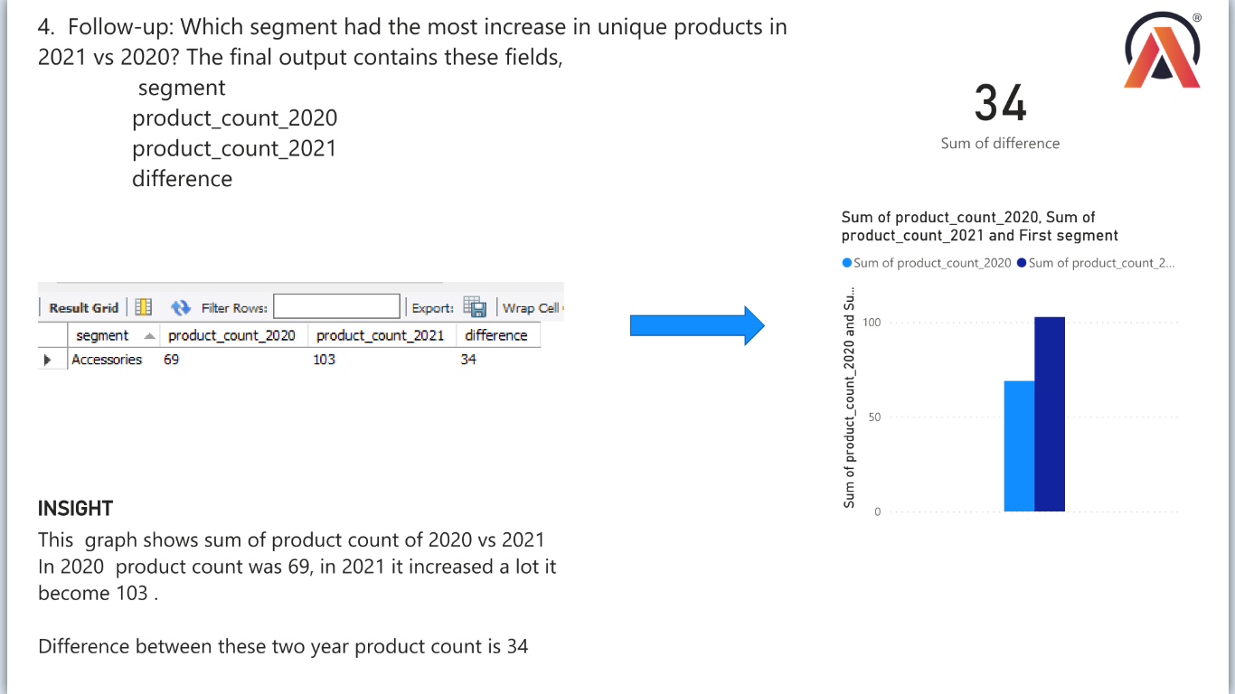
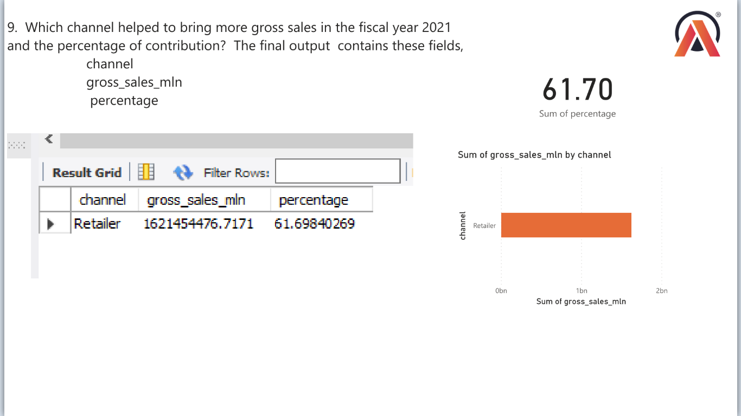
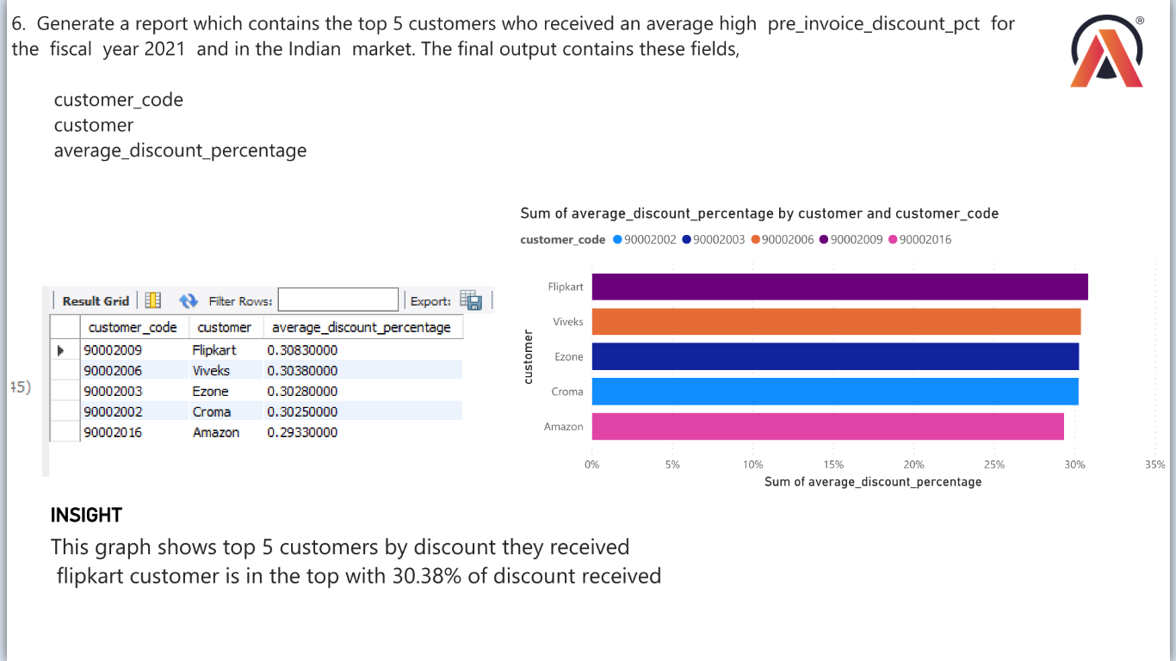
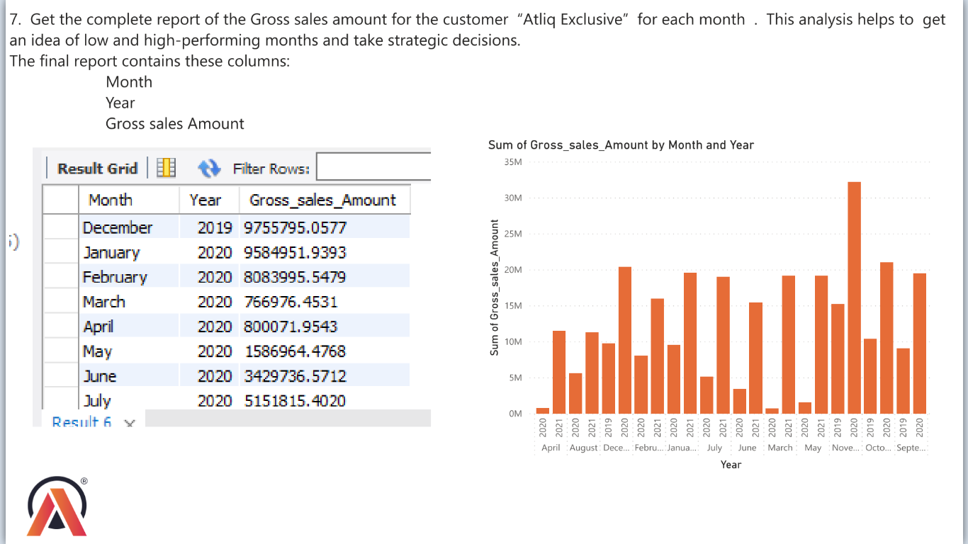
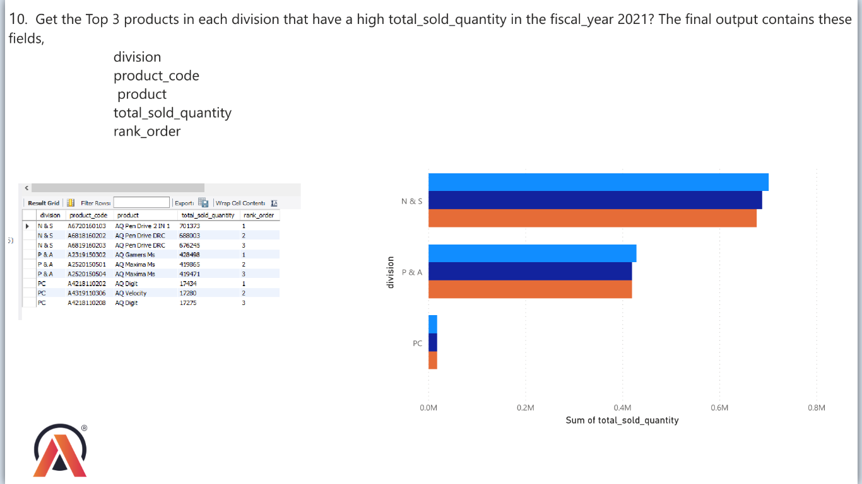
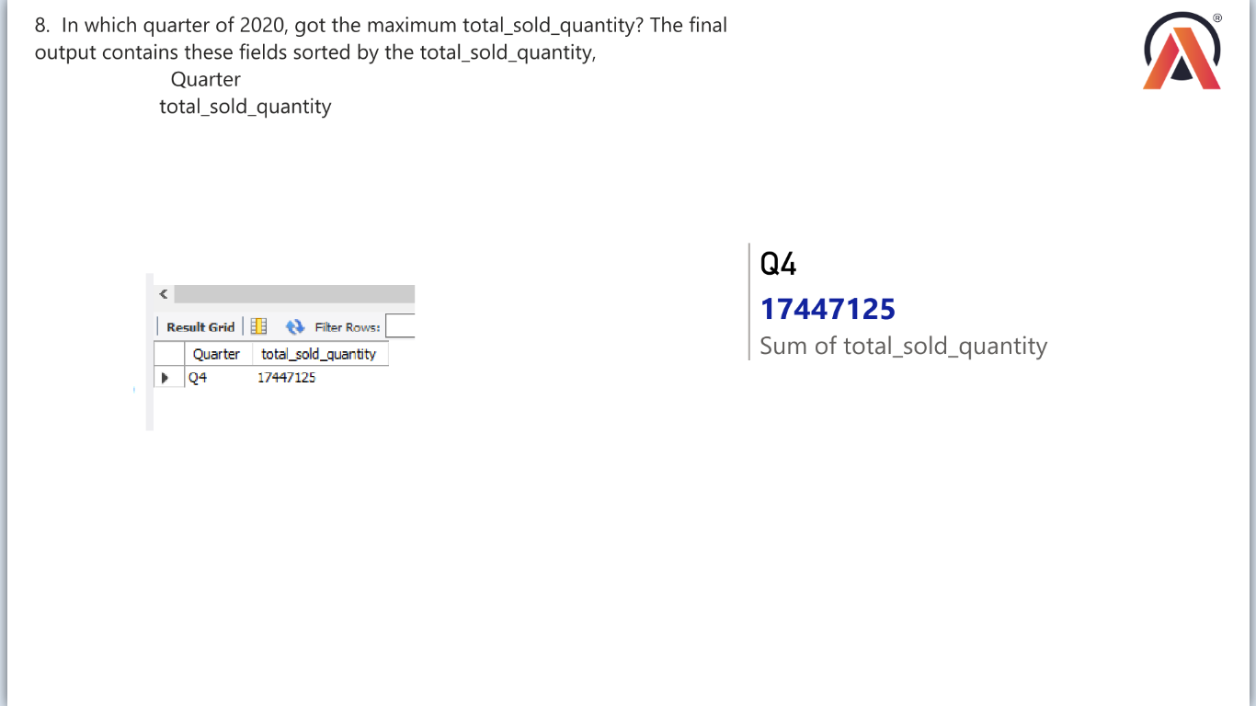
PROJECT
10
ATLIQ HARDWARE
SQL CHALLENGE
Atliq Hardwares (imaginary company) is one of the leading computer hardware producers in India and well expanded in other countries too. However, the management noticed that they do not get enough insights to make quick and smart data-informed decisions. They want to expand their data analytics team by adding several junior data analysts. Tony Sharma, their data analytics director wanted to hire someone who is good at both tech and soft skills. Hence, he decided to conduct a SQL challenge which will help him understand both the skills.

